Slide 1
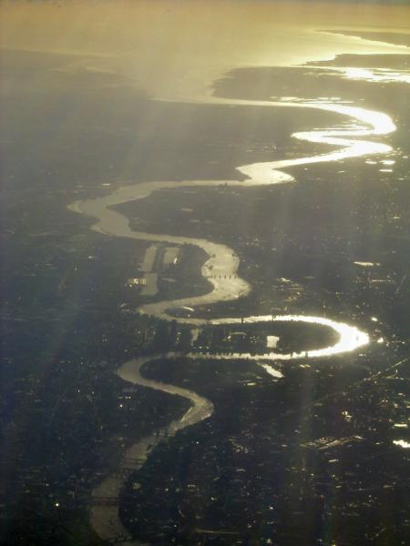
Mapping the Early Modern Thames shoreline
Early Modern Thames Maphackathon
Saturday, 11th February 2017 (9 am to 6 pm)
Sunday, 12th February 2017 (9 am to 6 pm)
Quayside Room, Museum of London Docklands

Slide 2
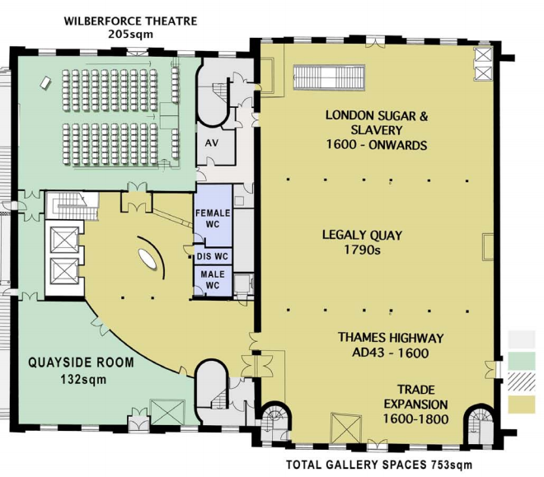
hack ideas
EARLY MODERN THAMES MAPHACKATHON
Eleven hack ideas have been proposed
Hack ideas looking for team members:
C17th/C18th Billingsgate fish market soundscape
Deptford Creek ship repair & refitting yards, 1669 soundscape & physical map [with Dr Amelia Fay, curator, Manitoba Museum, Canada]
Royal Naval shipyard at Deptford, late C17th 3D model [with Dr Amelia Fay, Manitoba Museum, Canada]
Directional & ambient riverine & shore sounds at Woolwich, November 1662 - [Dr Tom Irvine, musicologist and MarineLives]
417 years of River Thames hydrology [with Crystal Safadi]
Simulation model of ship, lighter & wherry movements on River Thames in C17th & C18th [with Crystal Safadi]
Mapping the incidence of malaria in marshlands and levels of Early Modern River Thames (borrowing Mary Dobson methodology + modern data mining) [with Deborah Leem]
Modelling the built environment of the Thames shoreline in C17th & C18th [with Dr Craig Spence]
Cartopop: Modifying David Rumsey cartography plug-in coded by Jack Reed (Geospatial engineer, Stanford University Library) to allowspecification of sub-set of maps for random display each time user opens a new Chrome window
Picturemash: Writing code to enable the creation of a large image repository, with combination of automated recognition + geolocation + community driven geolocation + tagging by date & theme
Nametag: Early Modern Thames geolocated gazeteer for automatic geotagging of places, buildings & topographical features, to be used to increase geospatial searchability of text corpora and scanned maps
Lots of opportunity to suggest new hack ideas, and to lead and form new teams, or to join existing ones
Source: Third floor plan, Museum of London Docklands
Saturday, 11th February 2017 (9 am to 6 pm); Sunday, 12th February 2017 (9 am to 6 pm) Quayside Room, Museum of London Docklands

Slide 3
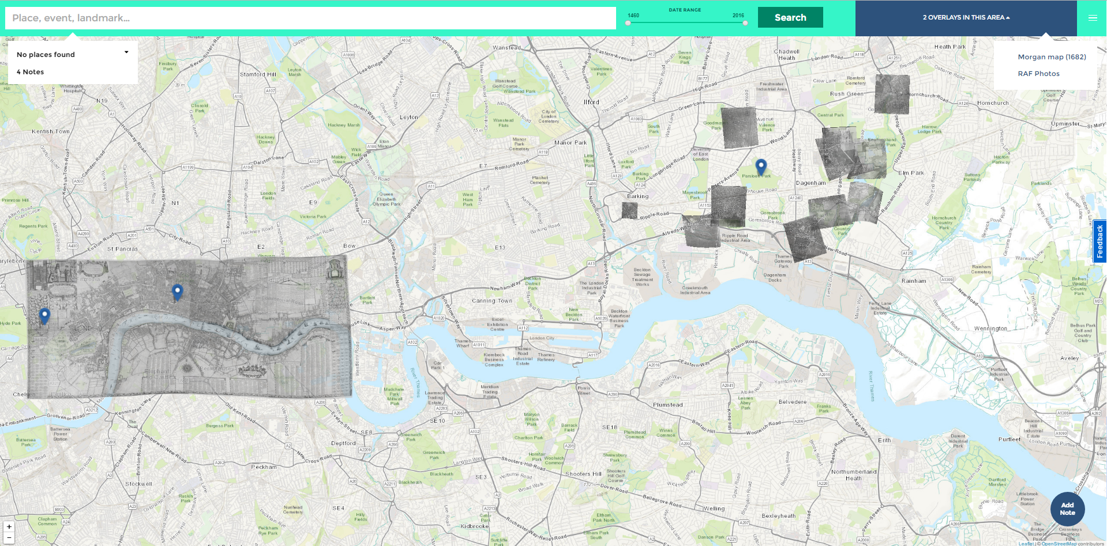
MAPHACKATHON
EARLY MODERN THAMES MAPHACKATHON
Geographical scope: London Bridge to Woolwich - Thames, foreshore, built shoreside, adjacent parishes
Billingsgate soundscape
Ship, lighter, wherry simulation model
417 years Thames hydrology
Mapping malaria
Mapping built environment
of shoreline
Deptford
Naval dockyard
3D model
Woolwich
soundscape
Built environment
Deptford
soundscape
Soundscapes
Red boundary marks Maphackathon geographical scope
Smellscapes
Saturday, 11th February 2017 (9 am to 6 pm); Sunday, 12th February 2017 (9 am to 6 pm) Quayside Room, Museum of London Docklands
Source: Layers of London, alpha test site, landing map: http://alpha.layersoflondon.org/the-map, Morgan map (1682) overlay; RAF aerial maps overlay; MarineLives & Maphackathon annotations

Slide 4
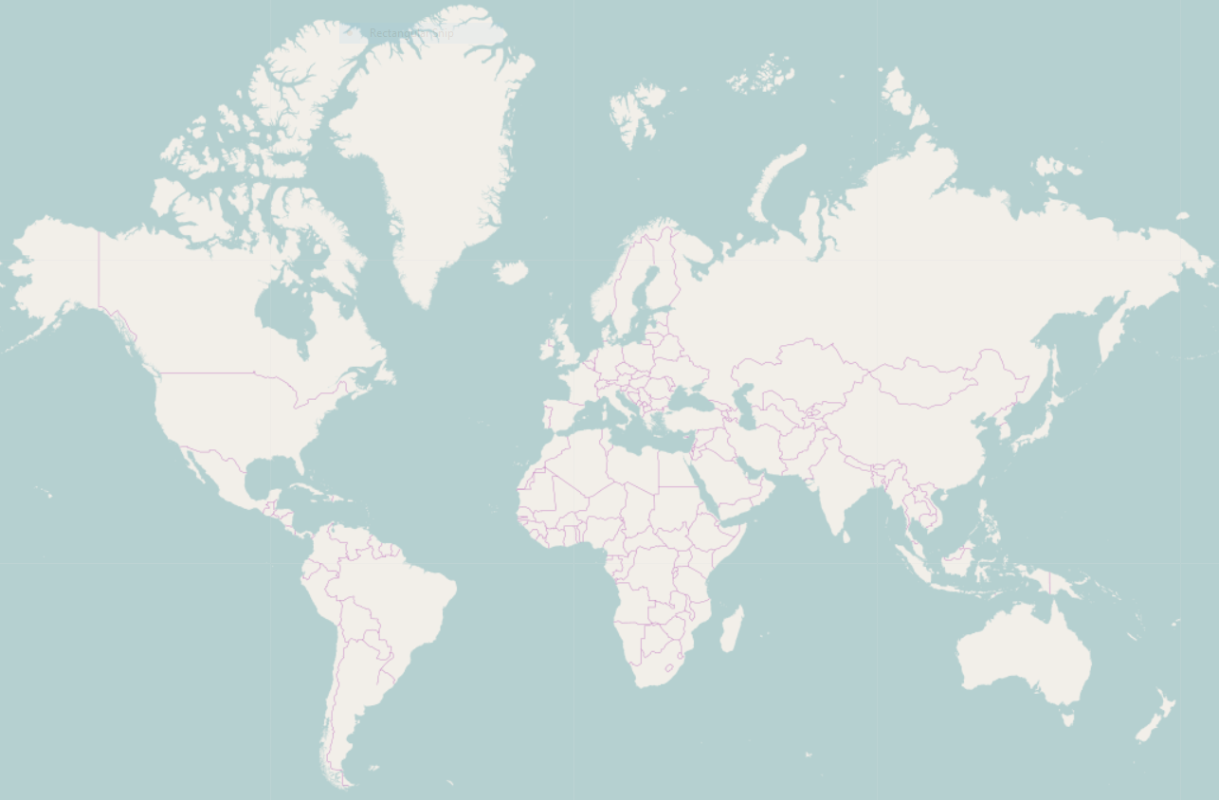

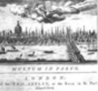













team members
EARLY MODERN THAMES MAPHACKATHON
Our virtual and physical team members are coming a long way
KEY
Virtual team
Travel to hack
Source: https://www.openstreetmap.org
With thanks to our financial sponsors and our technical, knowledge and data partners and providers

Slide 5


QGIS & ARCGIS WORKSHOP
EARLY MODERN THAMES MAPHACKATHON
Hands on afternoon workshop in QGIS & ArcGIS in the Cloud for historians, archaeologists, and musicologists – beginners & intermediate/advanced sessions
Go from a beginner to your first map layer and post your layer to the commons
Hone your intermediate mapping skills (vectorisation, layer making)
Tailored for the immediate needs of Maphackathon teams
Help with installation
Troubleshooting team problems
Strengthen your QGIS for historian skills as taught at the IHR and in the Programming Historian course material
Learn from Mike Turner, Head of GIS at Tideway, who does this propfessionally for London and the Thames
Early Modern Thames Maphackathon
Workshop 1: QGIS & ArcGIS
Saturday pm, February 11th, 2017
Quayside Room, Museum of London Docklands
Source: https://www.eventbrite.co.uk/e/maphackathon-tickets-30469473014

Slide 6
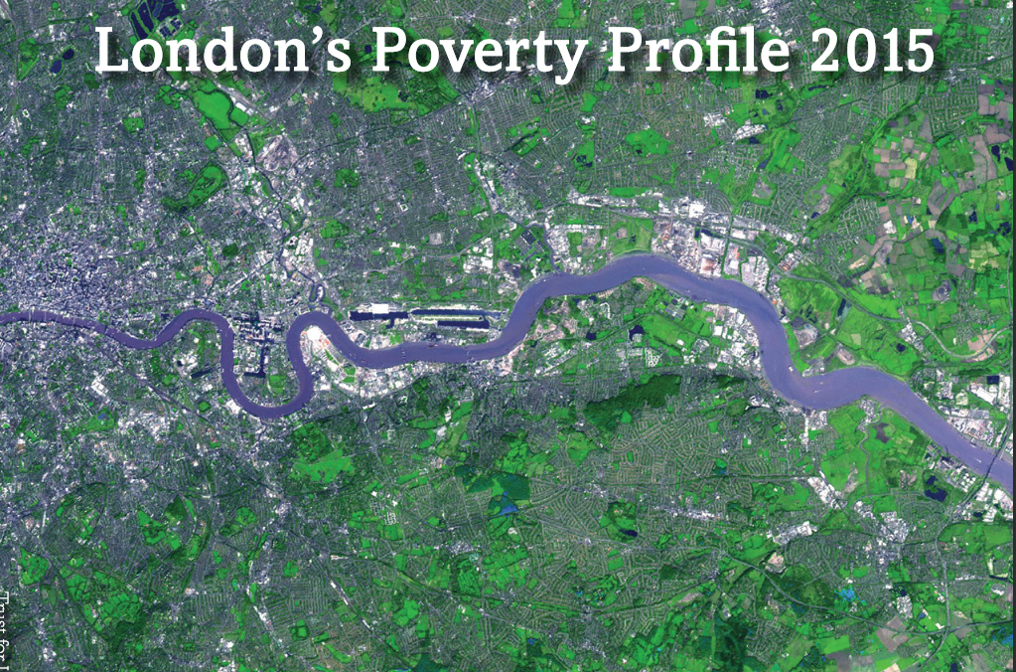
BUILT ENVIRONMENT
How does the social geography of the Early Modern Thames compare with today’s lived experience?
Source: Trust for London: Tackling poverty and inequality; http://www.londonspovertyprofile.org.uk/

Slide 7
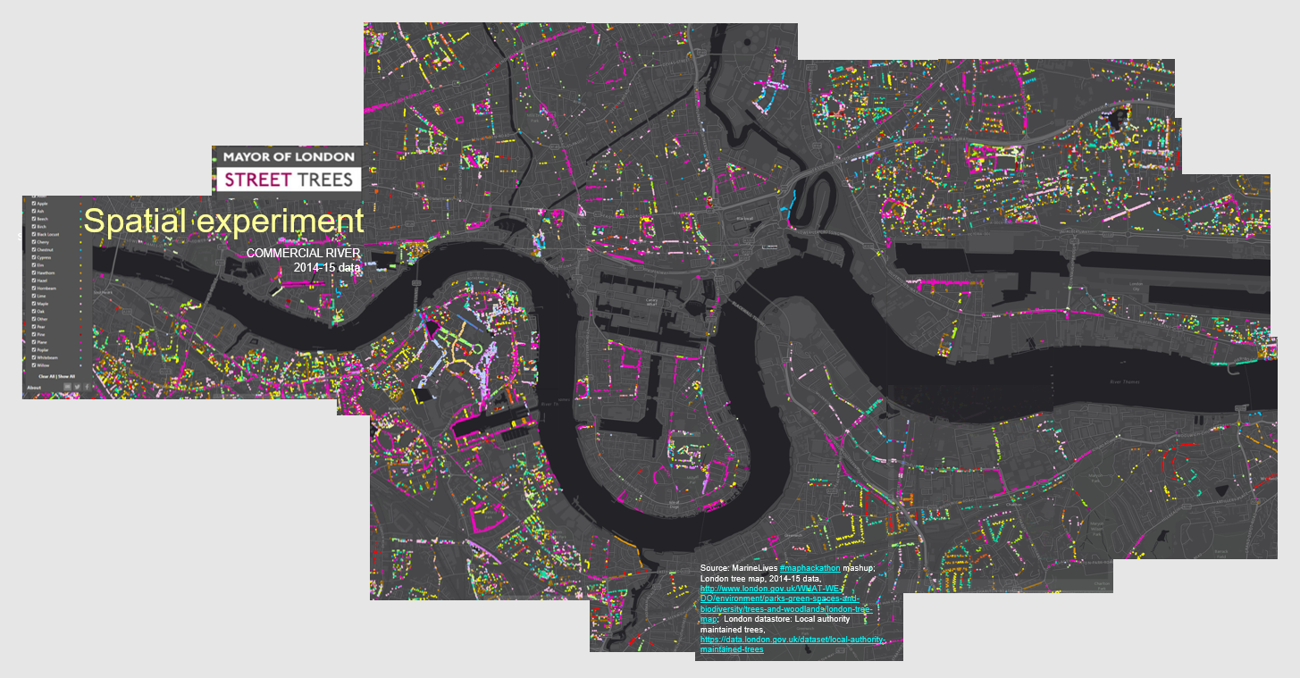
LAND USE
EARLY MODERN THAMES MAPHACKATHON
Where were the fields, the marshes and the trees along the Early Modern Thames?

Slide 8
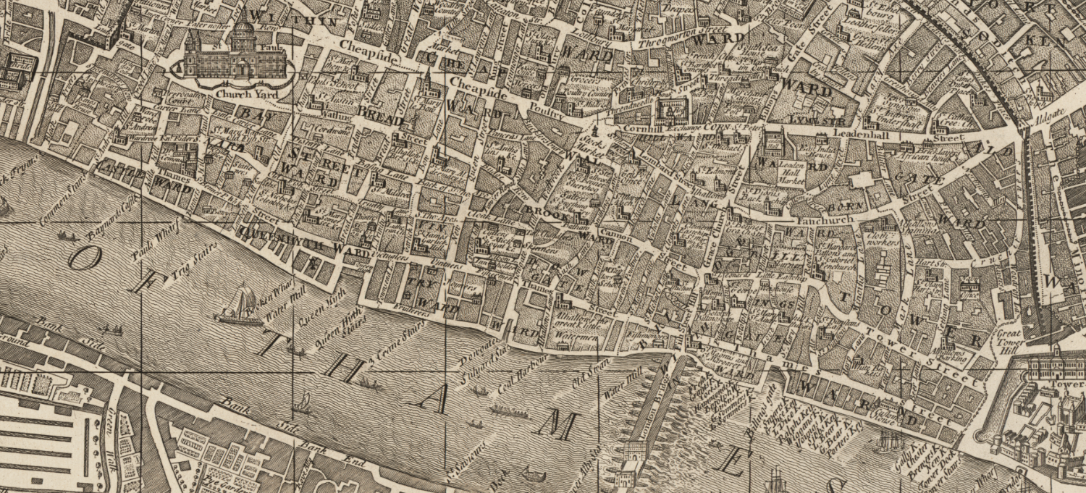
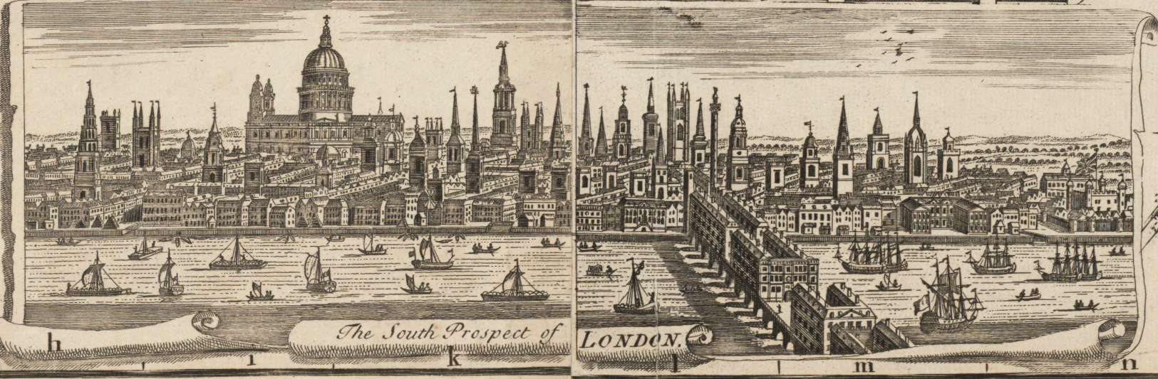
BUILT ENVIRONMENT
EARLY MODERN THAMES MAPHACKATHON
Built areas on north shore of Thames to west of London Bridge match buildings in south prospect of London inset in the same map (John Bowles, map of London (1742): Example - Watermill by Broken Wharf
Source: London, England (1742), raster image, printer: John Bowles, viewed in Stanford Universities Library Earthworks GIS viewer; digitised by Harvard University: https://earthworks.stanford.edu/catalog/harvard-g5754-l7-1

Slide 9
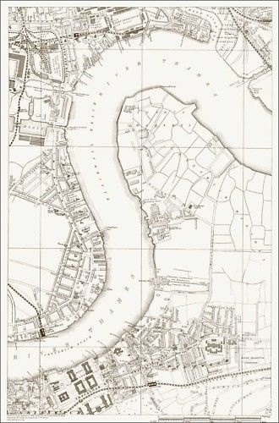
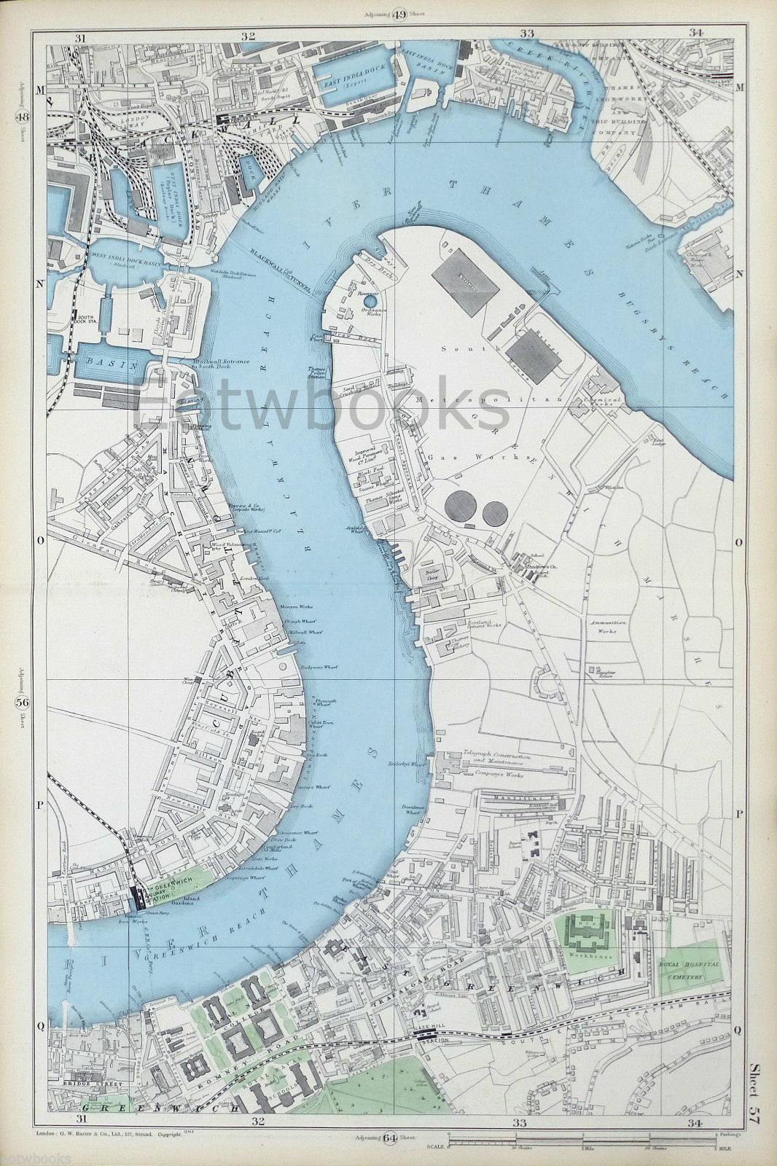
BUILT ENVIRONMENT
EARLY MODERN THAMES MAPHACKATHON
Bugsby marsh & Greenwich marsh, G.W. Bacon & Co.,1888 v. 1904
Source: Greenwich, Blackwall, Docklands sheet, 9 inches to mile, G.W. Bacon & Co, The Strand, 1888 & 1904, EOTW Books & Maps

Slide 10
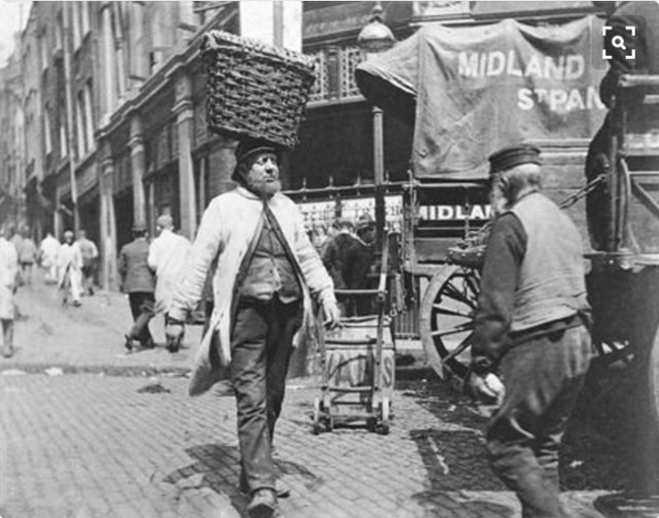
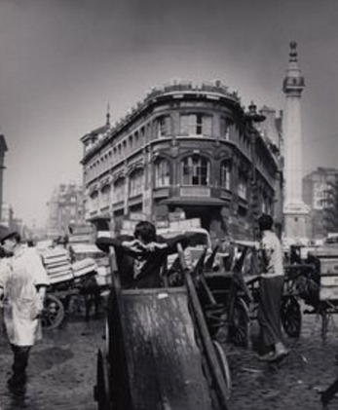
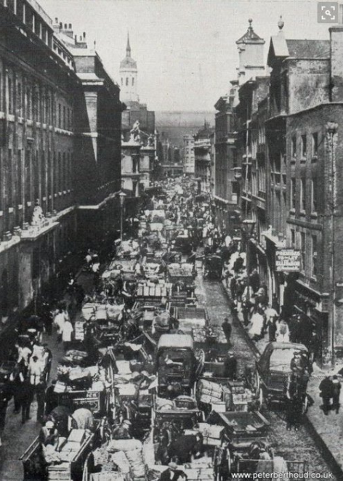
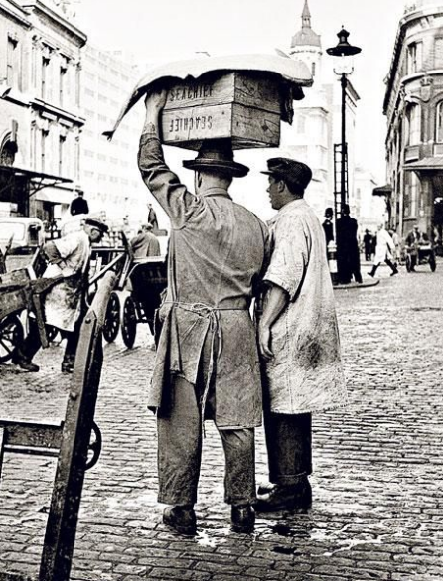
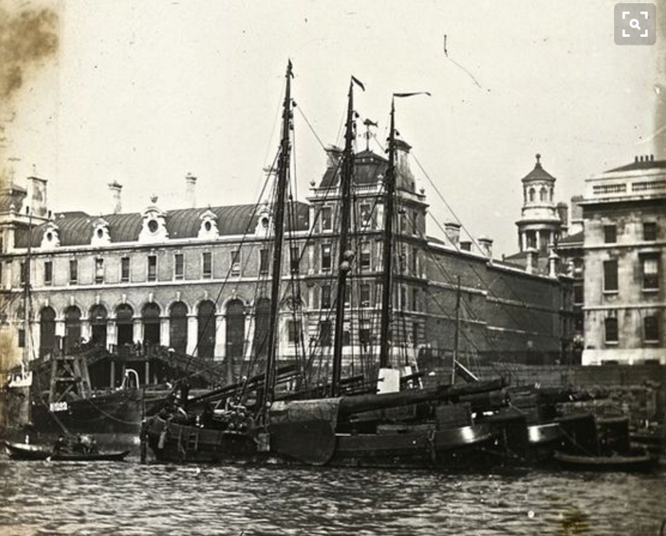
SOUNDSCAPE
EARLY MODERN THAMES MAPHACKATHON
We are forming a hack team to model & map C17th & early C18th Billingsgate fishmarket soundscape
Source: From TLH corner, clockwise (1) A fish porter at Billingsgate, 1893, Paul Martin, Museum of London Prints (2) Porters at Billingsgate, 1960s (3) Billingsgate Market, 1890s (4) Billingsgate Market, c. 1910, wayne.borrett@mgroup.co.uk (5) Billingsgate Porter, Vernon Stratton, Getty Images (4) Billingsgate Market

Slide 11
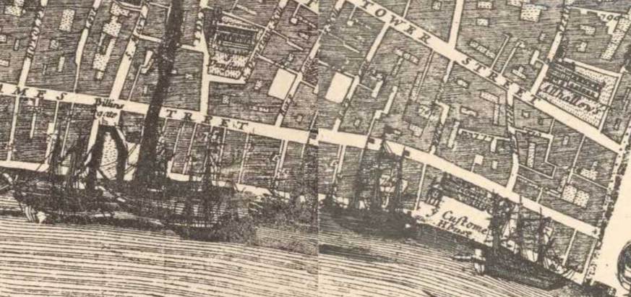
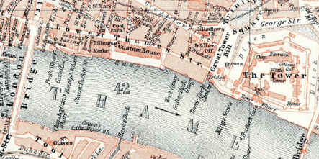
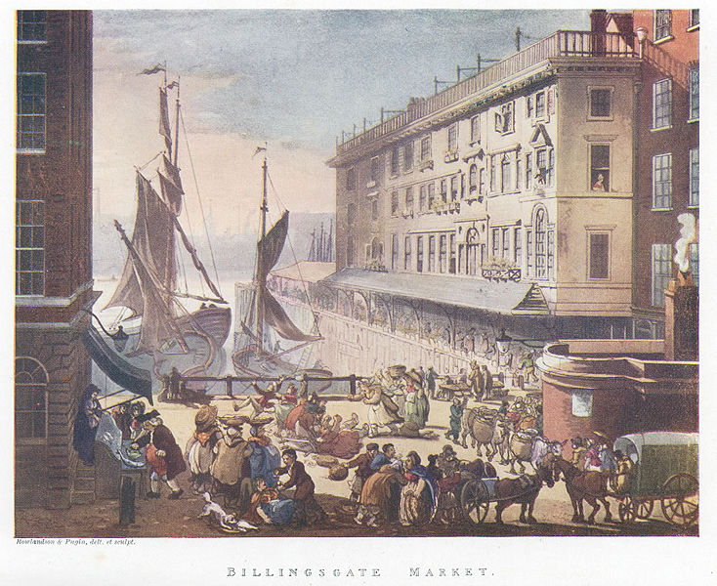
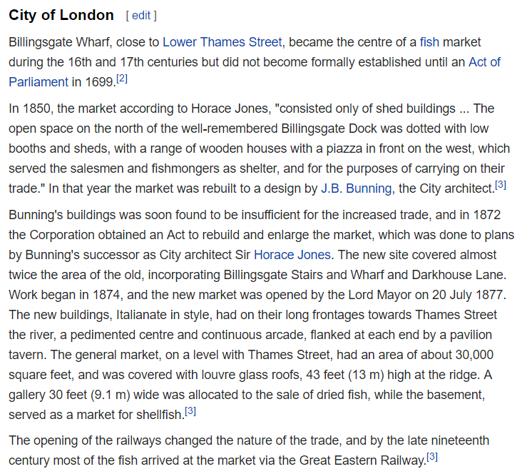
BILLINGSGATE SOUNDSCAPE HACK
EARLY MODERN THAMES MAPHACKATHON
Ian Rawes is forming a Billingsgate C17th/C18th soundscape Maphackathon hack team
1682
1911
c.1910
1808
Source: From TLH Corner: (1) Morgan's Map of the Whole of London in 1682, http://www.british-history.ac.uk/no-series/london-map-morgan/1682
(2) Detail from Baedeker "London and its Environs", sixteenth edition, Leipzig 1911, III. The City from St. Paul's to the Tower, http://www.ebay.co.uk/itm/London-City-Tower-Finsbury-Circus-1911-small-orig-city-map-Royal-Mint-St-Pauls-/132073496182?hash=item1ec0319e76 (3) Billingsgate Market, c. 1910, wayne.borrett@mgroup.co.uk (4) Billingsgate Fish Market, Wikipedia, https://en.wikipedia.org/wiki/Billingsgate_Fish_Market, viewed 26/01/2017 (5) Thomas Rowlandson, Augustus Charles Pugin after John Bluick, Joseph Constantine Stadler, and Thomas Sutherland, ‘Billingsgate’ in ‘The Microcosm of London or London in Miniature, vol. , plate 9 (1808), https://en.wikipedia.org/wiki/File:Billingsgatemicrocosm.jpg

Slide 12
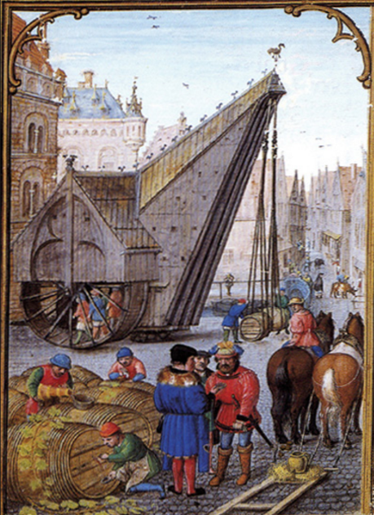
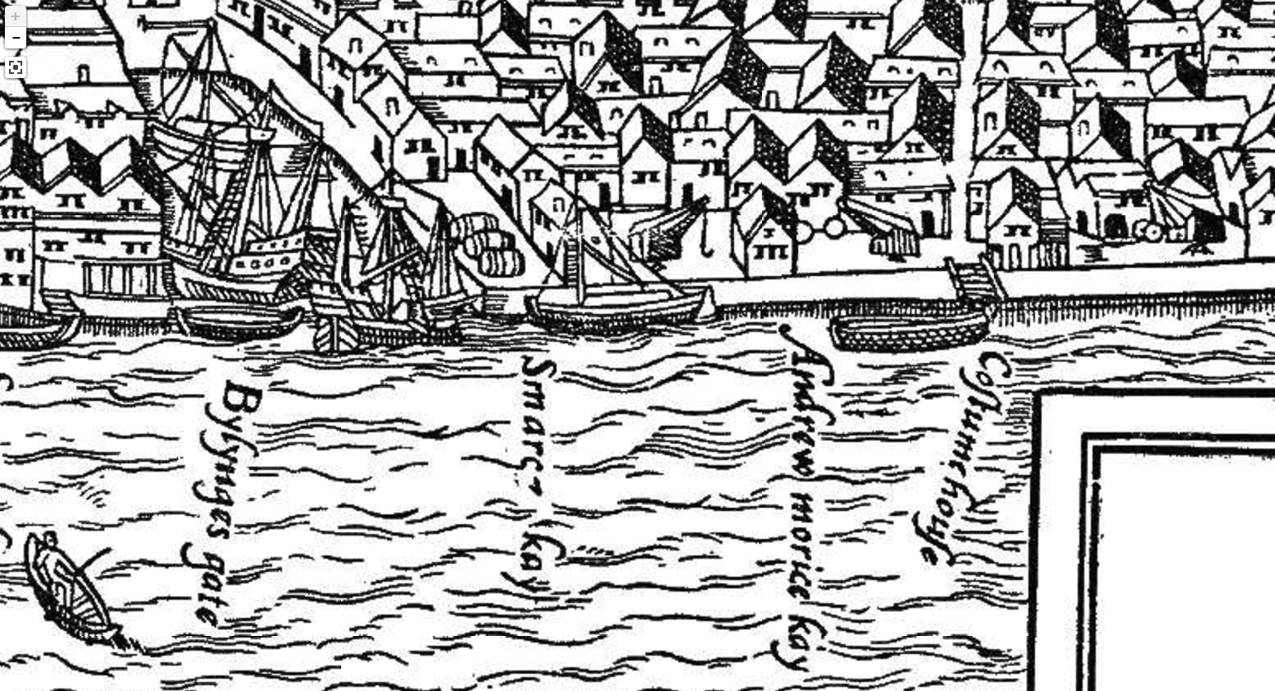
SOUNDSCAPE
EARLY MODERN THAMES MAPHACKATHON
What were the drivers of sound? Example: Early Modern Cranes
#maphackathon
Saturday, 11th February 2017 (9 am to 6 pm)
Sunday, 12th February 2017 (9 am to 6 pm)
Quayside room, Museum of London Docklands
Source: Agas Map of London, ca. 1650-1651, pub. C. 1633, probably derived from the ‘Copperplate’ map of c. 1650, of which three sheets exist, 'Plan of London (circa 1560 to 1570)', in Agas Map of London 1561 ([s.l.], 1633), British History Online, 'Plan of London (circa 1560 to 1570)', in Agas Map of London 1561 ([s.l.], 1633), British History Online
http://www.british-history.ac.uk/no-series/london-map-agas/1561 [accessed 15 December 2016]; Great Crane at Bruges,lifting wine barrels from a barge, four men walk inside the wheel on the near side of the crane, MIT online resource, http://web.mit.edu/21h.416/www/old/images/crane.html

Slide 13
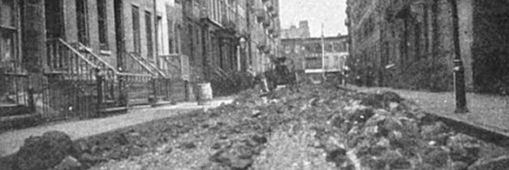
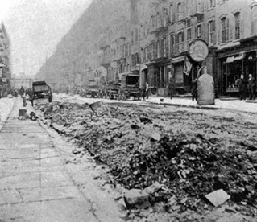
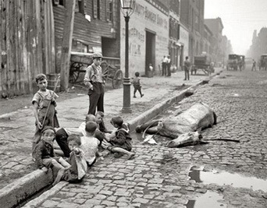
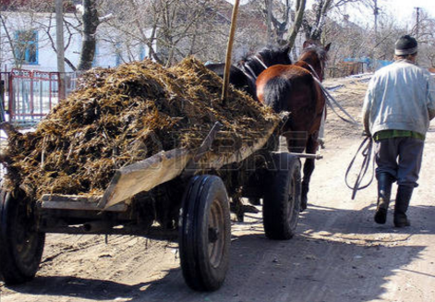
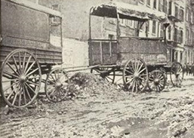
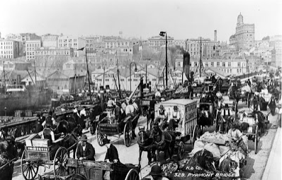
SMELLSCAPE
EARLY MODERN THAMES MAPHACKATHON
What did the Early Modern Thames shoreline smell like?
#maphackathon
Saturday, 11th February 2017 (9 am to 6 pm)
Sunday, 12th February 2017 (9 am to 6 pm)
Quayside Room, Museum of London Docklands
Source: ‘New York City's Streets Were Littered With Horse Manure, Carcasses’, in ‘6 Real Cities Destroyed By Incredibly Bizarre Apocalypses, blog article, Kathy Benjamin, May 25, 2016, http://www.cracked.com/article_24024_why-apocalypse-will-be-more-embarrassing-than-scary.html; ‘The great horse manure crisis of 1894’, blog article. Bytes, July 16, 2011, http://bytesdaily.blogspot.co.uk/2011/07/great-horse-manure-crisis-of-1894.html, photograph, Pymont Bridge, Sydney abput 1904; horse manure stock image

